Slide 1


Public Employees
Insurance Program (PEIP)
2027 Renewal Overview
Innovo Benefits Administration
www.innovomn.com

Slide 2
PEIP & Innovo Benefits Administration
The Public Employees Insurance Program (PEIP) is a state of Minnesota health plan available to cities, counties, school districts and other public employers. PEIP is able to leverage off the state employee plan and use the negotiating clout of their size to offer very low administrative costs and multiple network carriers to participating member groups.
Deloitte, the world’s largest professional services organization, handles the financials, underwriting, and consulting.
Innovo Benefits Administration is the third-party administrator for the PEIP program. Our core staff has worked with the PEIP program since it was created.
Our 30+ years of experience have proven instrumental in effectively addressing the needs of participating groups and members, helping to support the continued success of the PEIP program.
The PEIP pool has grown to approximately 280 employer groups covering 35,000 members.

Slide 3
2027 PEIP Renewal and Plan Changes
The 2027 clinic directory will be available approximately 10/15/2026 at www.innovomn.com. Please check to see if your clinic cost level has changed.
Innovo Benefits Administration encourages you to use our PEIP Online Enrollment Portal. You can access the Online Enrollment Portal by visiting – https://www.mnpeip.com. Please consult with your HR Office prior to submitting changes online.
No member action is required unless you are changing networks (BC/HP) or changing plan designs (High/HSA). If you are changing clinics only, please call the customer service number on your ID card.
Plan Changes for 2027
  The 90-day prescription copayment discount is being discontinued. Members can still get a 90-day supply of their prescriptions, but it will now be the standard 3 copayments.
  No medical benefit changes for 2027

Slide 4
Overview of PEIP Coverage
Two Plan Designs & Two Network Carriers
  Choose between two plan options and two network carriers.
Primary Care Clinic (PCC) Model
  All members assign a PCC.
  Clinics are assigned a cost level (1-4) based on their efficiency and overall care delivery costs – more efficient, lower-cost clinics are placed in lower cost levels.
  Your benefit level is determined by the cost level of your assigned PCC – lower cost levels generally provide richer benefits.
Coordinated Care Through Your PCC
  Most routine and non-emergency care is managed through your PCC.
  Referrals are typically required for care outside your PCC.
Prescription Drug Coverage
  Provided through CVS Caremark for both network carriers.
  Access a nationwide network of pharmacies – you are not limited to CVS retail locations.

Slide 5
PEIP Step-by-Step Guide
Step 1: Choose Your Plan Level
Advantage High Plan
HSA-Compatible Plan
Step 2: Choose Your Network Carrier
HealthPartners
Blue Cross Blue Shield
Step 3: Choose Your Primary Care Clinic (PCC)

Slide 6
Step 1 – Choose Your Plan Level
Available Plan Options:
  Advantage High Plan
    Offers a higher level of benefits.
    Comes with a higher payroll deduction.
  HSA-Compatible Plan
    Has higher deductible and out-of-pocket expenses.
    Comes with a lower payroll deduction.
For family coverage, one plan covers all family members.
Plan level can be changed annually during open enrollment.

Slide 7
Step 2 – Choose Your Network Carrier
Available Network Carriers:
  HealthPartners
  Blue Cross Blue Shield
Network carrier selection does not affect plan cost or premium.
Both network carriers offer both plan design levels.
One network carrier must be selected for family coverage.
Network carrier can be changed annually during open enrollment.

Slide 8
Step 3 – Choose Your Primary Care Clinic (PCC)
All members must designate a Primary Care Clinic (PCC) through which all planned and routine care is coordinated.
PCCs are assigned a cost level (1–4) based on efficiency and total cost of care delivery.
  More efficient clinics with lower care delivery costs are placed in lower cost levels.
  Lower cost levels generally correspond to richer benefits, including lower deductibles, copays, coinsurance, and out-of-pocket maximums.
  For family coverage, each family member may select a different clinic, regardless of cost level.
PCCs can be changed anytime by contacting your network carrier.
PCC directory available online at www.innovomn.com.

Slide 9
Referrals
Most medical care is coordinated through your Primary Care Clinic (PCC).
A referral from your PCC is generally required to see a specialist.
Referrals to specialists are covered at the same cost level as your PCC.
You may self-refer* for:
  OBGYN
  Chiropractic Care
  Vision Care
  Mental Health/Chemical Dependency
    *Self-referral is allowed only if the provider is part of your network carrier’s self-referral network
No referrals are needed for:
  Urgent Care
  Emergency Room Visits

Slide 10
Prescription Drug Coverage
CVS Caremark is the pharmacy benefit manager (PBM) for PEIP, serving both HealthPartners and Blue Cross Blue Shield members.
Access to a nationwide network of 68,000+ participating retail pharmacies, including both CVS and non-CVS locations.
Use the pharmacy locator at www.innovomn.com to find participating pharmacies.
Convenient options include retail, specialty pharmacy services, and mail-order delivery.
Members receive two ID cards:
  Medical ID card from network carrier (HealthPartners or Blue Cross Blue Shield).
  Pharmacy ID card from CVS Caremark.

Slide 11
Advantage High Plan

Slide 12
Deductible
Advantage High Plan
Benefit Provision | Cost Level 1 | Cost Level 2 | Cost Level 3 | Cost Level 4
A. Preventive Care Services | You Pay Nothing | You Pay Nothing | You Pay Nothing | You Pay Nothing
B. Deductible (single / family) | $250 / $500 | $400 / $800 | $750 / $1,500 | $1,500 / $3,000
Deductible
The amount you pay out-of-pocket for covered services before your health plan starts to pay.
Applies annually and resets each calendar year.
Example: If your deductible is $400, you pay the first $400 of covered services yourself.
  Cost Level 2: $400 single / $800 family
  Range across Cost Levels 1–4: $250–$1,500 single / $500–$3,000 family
Important Notes:
Certain services, such as preventive care and convenience clinics/online care, are covered at 100% and not subject to the deductible.
Family coverage includes an embedded deductible: if one family member meets the single amount, their deductible is satisfied – they don’t need to wait for the family total.
Cost Level 2 is emphasized throughout these materials because it serves as the benchmark for the plan. The State ensures that Cost Level 2 clinics are geographically accessible to all enrollees, and the majority of PEIP members choose a Cost Level 2 clinic.

Slide 13
Copay & Coinsurance Coverage
Advantage High Plan
Benefit Provision | Cost Level 1 | Cost Level 2 | Cost Level 3 | Cost Level 4
C. Office Visits Illness/Injury, Therapy, Urgent Care (deductible applies) | $35 copay | $40 copay | $70 copay | $90 copay
Mental Health/Substance Use Disorder Office Visits (not subject to deductible for CL 1 & 2) | $0 copay | $0 copay | $40 copay | $60 copay
E. Emergency Room Care (not subject to deductible) | $100 copay | $125 copay | $150 copay | $350 copay
F. Inpatient Hospital (deductible applies) | $100 copay | $200 copay | $500 copay | 25% coinsurance
G. Outpatient Surgery (deductible applies) | $60 copay | $120 copay | $250 copay | 25% coinsurance
J. Lab, Pathology, and X-ray (deductible applies) | 10% coinsurance | 10% coinsurance | 20% coinsurance | 25% coinsurance
Copay: A fixed amount you pay for a service (ex. $40 for an office visit).
Coinsurance: A percentage you pay of the total billed amount (ex. 10% of a lab bill).
Important Notes:
The deductible applies to most services that involve a copay or coinsurance, but not all. For example, emergency care is not subject to the deductible. Always refer to the benefit provision details to confirm whether the deductible applies to a specific service.
The services outlined above represent commonly covered benefits, but do not include all available coverage. Please consult the official plan documents for a complete and detailed description of benefits and exclusions.
Cost Level 2 is emphasized throughout these materials because it serves as the benchmark for the plan. The State ensures that Cost Level 2 clinics are geographically accessible to all enrollees, and the majority of PEIP members choose a Cost Level 2 clinic.

Slide 14
Out-of-Pocket Maximum
Advantage High Plan
Benefit Provision | Cost Level 1 | Cost Level 2 | Cost Level 3 | Cost Level 4
O. Medical Out-of-Pocket Maximum (single / family) | $1,700 / $3,400 | $1,700 / $3,400 | $2,400 / $4,800 | $3,600 / $7,200
Out-of-Pocket Maximum (Medical Only)
The most you’ll pay in a year for covered services, including deductibles, copays, and coinsurance.
Once you reach this limit, the plan pays 100% of covered services for the rest of the year.
Cost Level 2: $1,700 single / $3,400 family
Range across Cost Levels 1–4: $1,700–$3,600 individual / $3,400–$7,200 family
Cost Level 2 is emphasized throughout these materials because it serves as the benchmark for the plan. The State ensures that Cost Level 2 clinics are geographically accessible to all enrollees, and the majority of PEIP members choose a Cost Level 2 clinic.

Slide 15
Prescription Drug Coverage
Advantage High Plan
Benefit Provision | All Cost Levels (1-4)
M. Prescription Drugs 30-day supply copay (Tier 1 / Tier 2 / Tier 3) | $18 / $30 / $55
N. Prescription Drug Out-of-Pocket Maximum (single / family) | $1,050 / $2,100
Prescription Drug Tiers
Tier 1 ($18) – Generic and commonly used name-brand medications.
Tier 2 ($30) – Name-brand drugs, some generics, and certain specialty medications.
Tier 3 ($55) – Typically higher-cost specialty medications.
If the cost of a medication is less than the copay amount, you only pay the actual price of the medication.
No Deductible
Prescription drug coverage under the High plan is not subject to the annual deductible.
Separate Out-of-Pocket Maximum
There is a separate prescription drug out-of-pocket maximum.
  $1,050 individual / $2,100 family (all cost levels)

Slide 16
HSA-Compatible Plan

Slide 17
Deductible
HSA-Compatible Plan
Benefit Provision | Cost Level 1 | Cost Level 2 | Cost Level 3 | Cost Level 4
A. Preventive Care Services | You Pay Nothing | You Pay Nothing | You Pay Nothing | You Pay Nothing
B. Med/Rx Deductible – Single | $1,750 | $2,250 | $3,250 | $4,250
Med/Rx Deductible – Family (per member / total) | $3,500 / $4,000 | $3,750 / $4,500 | $5,250 / $6,500 | $6,750 / $8,500
Deductible
The amount you pay out-of-pocket for covered services before your health plan starts to pay.
Applies annually and resets each calendar year.
Example: If your deductible is $2,250, you pay the first $2,250 of covered services yourself.
  Cost Level 2: $2,250 single / $4,500 family
  Range across Cost Levels 1–4: $1,750–$4,250 single / $4,000–$8,500 family
Important Notes:
Preventive care is covered at 100% and not subject to the deductible.
Medical and Prescription Drug expenses are combined under a single deductible.
Amounts are split between single and family coverage, with family coverage having a separate embedded deductible for each family member.
Cost Level 2 is emphasized throughout these materials because it serves as the benchmark for the plan. The State ensures that Cost Level 2 clinics are geographically accessible to all enrollees, and the majority of PEIP members choose a Cost Level 2 clinic.

Slide 18
Copay & Coinsurance Coverage
HSA-Compatible Plan
Benefit Provision | Cost Level 1 | Cost Level 2 | Cost Level 3 | Cost Level 4
C. Office Visits Illness/Injury, Therapy, Urgent Care (deductible applies) | $45 copay | $55 copay | $105 copay | $130 copay
Mental Health/Substance Use Disorder Office Visits (deductible applies) | $0 copay | $0 copay | $75 copay | $100 copay
D. Convenience Clinics & Online Care (deductible applies) | $0 copay | $0 copay | $0 copay | $0 copay
E. Emergency Room Care (deductible applies) | $250 copay | $300 copay | $350 copay | $600 copay
F. Inpatient Hospital (deductible applies) | $400 copay | $650 copay | $1,500 copay | 50% coinsurance
G. Outpatient Surgery (deductible applies) | $250 copay | $400 copay | $800 copay | 50% coinsurance
J. Lab, Pathology, X-Ray (deductible applies) | 20% coinsurance | 25% coinsurance | 30% coinsurance | 50% coinsurance
Copay: A fixed amount you pay for a service (ex. $55 for an office visit).
Coinsurance: A percentage you pay of the total billed amount (ex. 25% of a lab bill).
Important Notes:
The deductible applies to all services that involve a copay or coinsurance under the HSA plan, with the exception of preventive care.
The services outlined above represent commonly covered benefits, but do not include all available coverage. Please consult the official plan documents for a complete and detailed description of benefits and exclusions.
Cost Level 2 is emphasized throughout these materials because it serves as the benchmark for the plan. The State ensures that Cost Level 2 clinics are geographically accessible to all enrollees, and the majority of PEIP members choose a Cost Level 2 clinic.

Slide 19
Out-of-Pocket Maximum
HSA-Compatible Plan
Benefit Provision | Cost Level 1 | Cost Level 2 | Cost Level 3 | Cost Level 4
N. Med/Rx Out-of-Pocket Maximum – Single | $3,250 | $3,250 | $4,250 | $5,250
Med/Rx Out-of-Pocket Maximum – Family (per member / total) | $5,250 / $6,500 | $5,250 / $6,500 | $7,250 / $8,500 | $7,250 / $10,500
Out-of-Pocket Maximum
The most you’ll pay in a year for covered services, including deductibles, copays, and coinsurance.
Once you reach this limit, the plan pays 100% of covered services for the rest of the year.
Cost Level 2: $3,250 single / $6,500 family
Range across Cost Levels 1–4: $3,250–$5,250 single / $6,500–$10,500 family
Important Notes:
Medical and Prescription Drug expenses are combined under a single out-of-pocket maximum.
Amounts are split between single and family coverage, with family coverage including a separate embedded out-of-pocket maximum for each family member.
Cost Level 2 is emphasized throughout these materials because it serves as the benchmark for the plan. The State ensures that Cost Level 2 clinics are geographically accessible to all enrollees, and the majority of PEIP members choose a Cost Level 2 clinic.

Slide 20
Prescription Drug Coverage
HSA-Compatible Plan
Benefit Provision | All Cost Levels (1–4)
M. Prescription Drugs 30-day supply copay (Tier 1 / Tier 2 / Tier 3) (deductible applies) | $30 / $50 / $75
Prescription Drug Tiers
Tier 1 ($30) – Generic and commonly used name-brand medications.
Tier 2 ($50) – Name-brand drugs, some generics, and certain specialty medications.
Tier 3 ($75) – Typically higher-cost specialty medications.
If the cost of a medication is less than the copay amount, you only pay the actual price of the medication.
Important Note:
Prescription drug coverage on the HSA plan is subject to the combined medical/Rx deductible and counts toward the combined medical/Rx out-of-pocket maximum.

Slide 21
Out-of-Area Coverage
Out-of-Area Care: Care received outside of Minnesota and its bordering counties.
Advantage High Plan
  Deductible: $750 single / $1,500 family
  Cost Level 3 coverage after deductible
HSA-Compatible Plan
  Deductible: $1,750 single / $4,000 family (includes $3,500 embedded deductible per family member)
  30% coinsurance after deductible
Important Notes:
Out-of-area deductibles are separate from in-area deductibles but accumulate to out-of-pocket maximums.
Urgent care and emergency services are covered at the regular in-area assigned PCC cost level.
For coverage, the provider must participate in your carrier’s national network. Always call the number on your ID card to verify benefits before receiving care.

Slide 22
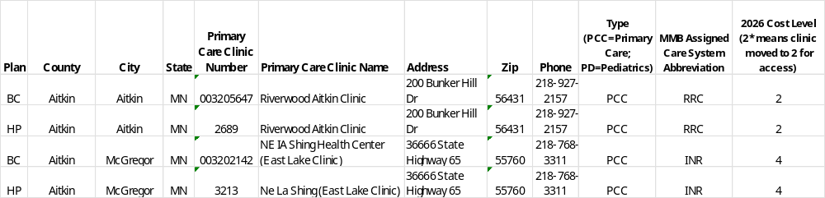
Enrollment Tips & Reminders
Choose Your Options
  Network Carrier: HealthPartners or Blue Cross Blue Shield
  Plan Level: Advantage High Plan or HSA-Compatible Plan
  Coverage Level: Single, Family, or other possible combinations such as Employee + Spouse or Employee + Child(ren)
Assign Your Primary Care Clinic (PCC)
  For family coverage, all family members must assign a PCC.
  Be sure to note the clinic cost level and ensure the PCC # matches your selected network carrier (HP or BC) when enrolling.
⚠️ Complete your enrollment thoroughly. Missing information may delay coverage activation.

Slide 23
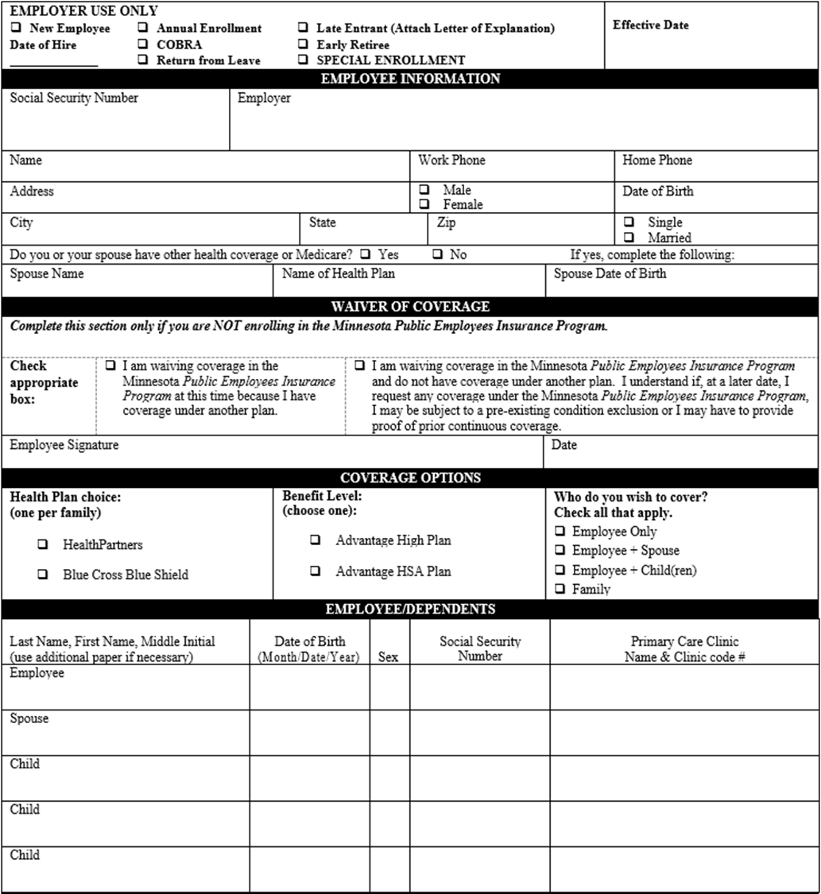
Enrollment Form
1
  1. Complete Employee Information Section.
  2. Waiver of coverage
    Only fill this section out if you are no longer going to be enrolled and you want to terminate coverage at open enrollment
  3. Coverage Options
    Choose your health plan network(HP or BC)
    Choose your plan level (High or HSA)
    Choose your coverage level.
  4. Complete information for all family members. Be sure to include the name and PCC # for all family members. (Match PCC # to the health plan network you choose.)
2
3
4

Slide 24
PEIP Plan Documents and Resources
All PEIP plan documents and resources are available online at www.innovomn.com, including:
  Plan Summaries & Documents
  Statewide Clinic Directory
  Summary Benefit Comparisons (SBCs)
  Pharmacy Tools
  Informative Q&A
Contact PEIP Support:
  Phone: 952-746-3101 or 800-829-5601
  Email: service@innovomn.com
Customer Service Hours: Monday–Friday, 7:30 AM – 4:30 PM

Slide 25

Thank You!
PEIP website – www.innovomn.com
For questions regarding PEIP medical coverage,
contact Innovo via phone or email.
952-746-3101 or 800-829-5601
M-F 7:30am – 4:30pm
shawn@innovomn.com
dan@innovomn.com
henry@innovomn.com
service@innovomn.com

Slide 26
Appendix

Slide 27
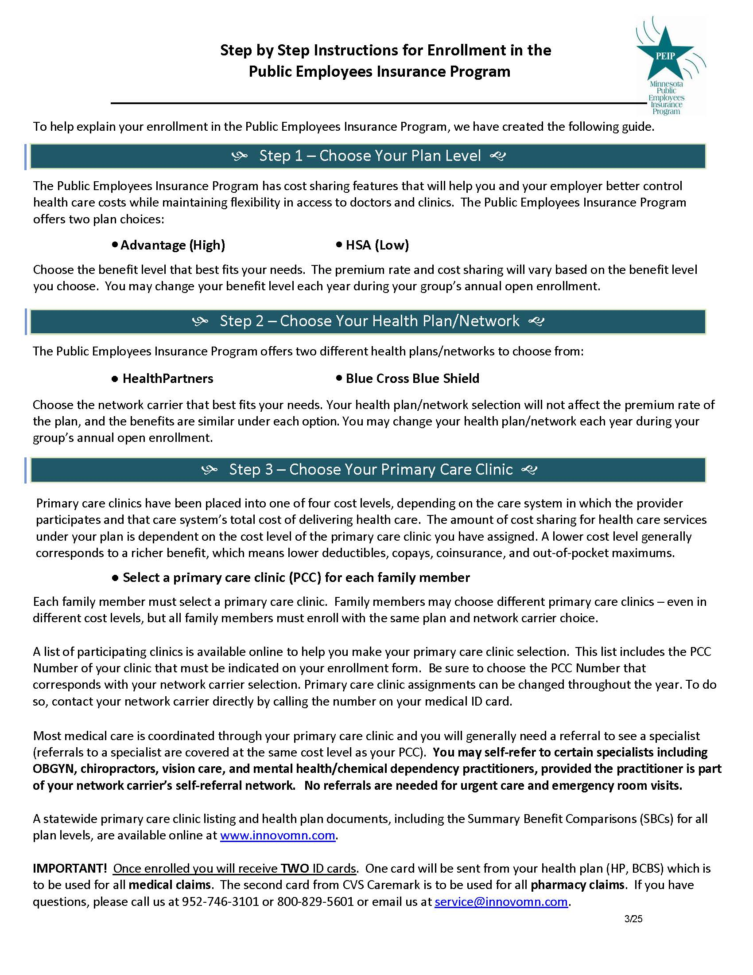

Slide 28
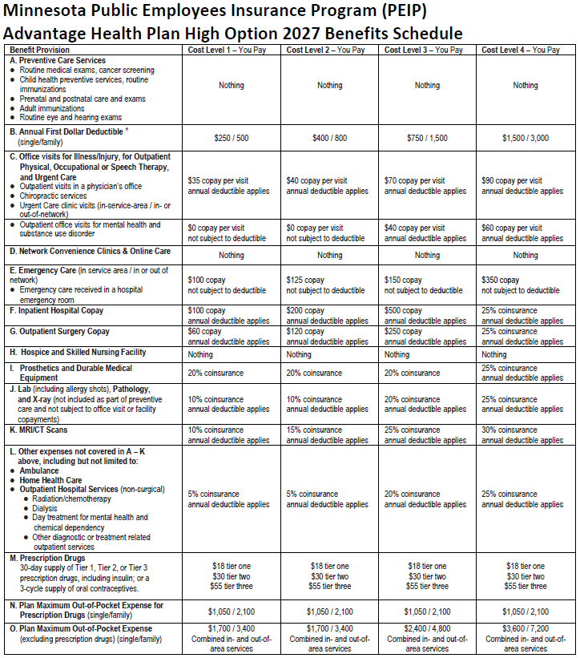

Slide 29
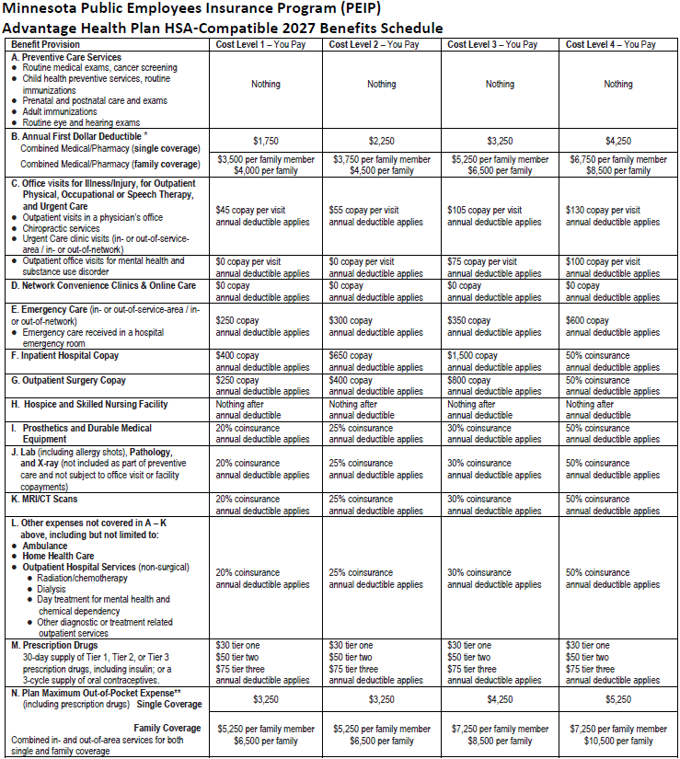

Slide 30
